Slide 1
SAP BTP RAP Training
Day 20
Anubhav Oberoy
www.AnubhavTrainings.com
Follow excellence with sheer passion

Slide 2


DISCLAIMER
The training content and delivery of this presentation is confidential, and cannot be recorded, or copied and distributed to any third party, without the written consent of Anubhav Trainings

Slide 3
Agenda – Day 20
01
Challenges for ABAP Developers
02
RAP - Introduction
03
Managed v/s Unmanaged RAP

Slide 4





Challenges in ABAP development
UI
Common needs
Create application logic
Insert, update, delete, validate, select data
Perform validations
Check customizing
Handle locks
Create A/c documents
Manage Documents
Application Code
I, U, D, S, V
Search Documents
Validate before save
Alex, ABAP Developer,
SAP FICO
UI
Challenges
Thinks differently
Adapt application code
High maintenance
No standardization
Different coding practices
Lack of standard
Create Sales Orders
Manage Sales Orders
Application Code
I, U, D, S, V
Search/Filter Sales Order
Compute Sales total
Stella, ABAP Developer,
SAP SD
www.anubhavtrainings.com

Slide 5
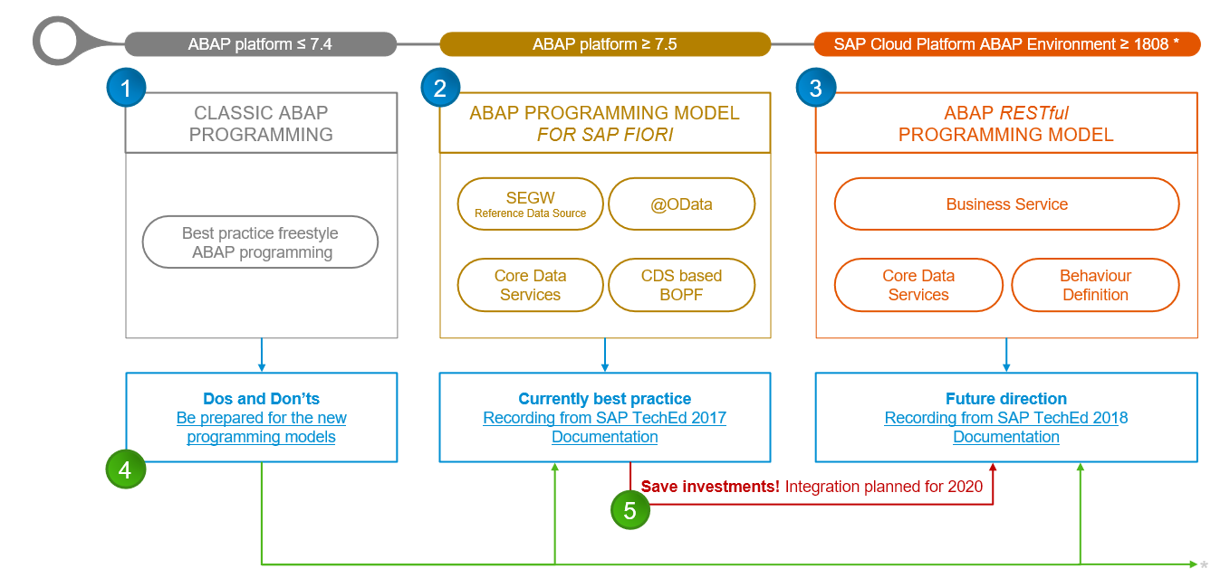
Evolution of ABAP Programming Model
www.anubhavtrainings.com

Slide 6
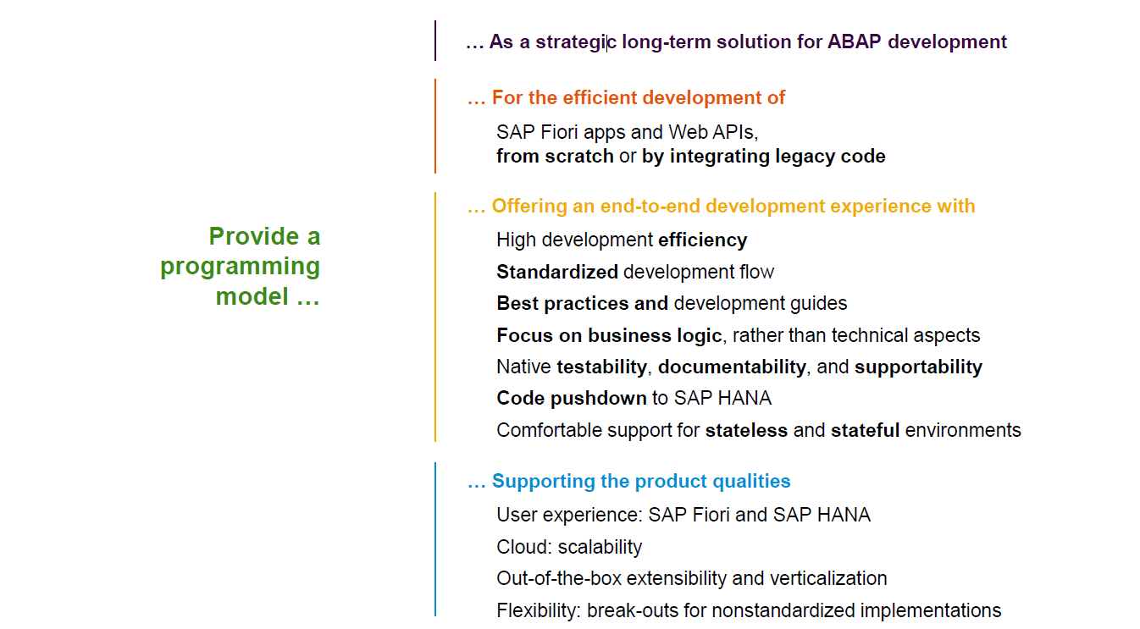
Restful ABAP Programming
www.anubhavtrainings.com

Slide 7
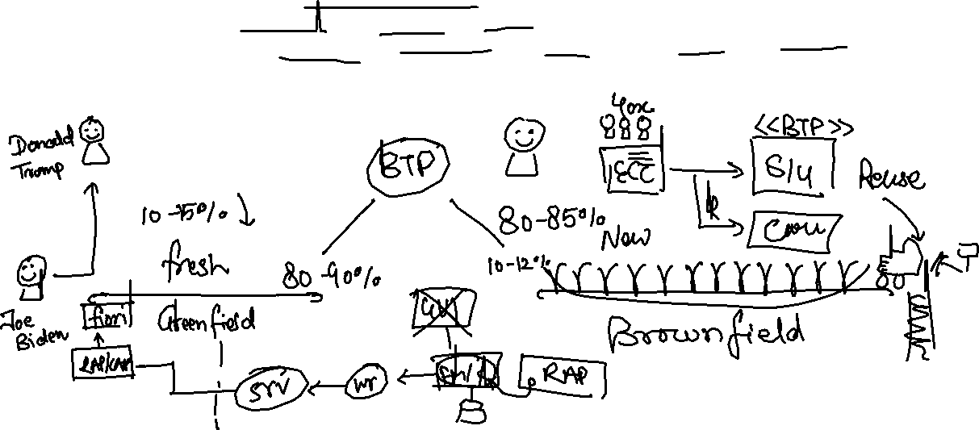
Restful Application Programming
The ABAP RAP (Restful Application Programming) Model defines the architecture for efficient application development for HANA optimized ABAP applications. It supports development of
Greenfield applications – A completely new application from scratch
Brownfield applications – A new/extension of application using OLD code
It is based on proven technologies and frameworks such as CDS entities to define semantically rich data model and service model infrastructure for creating and binding OData services for different use cases e.g. Fiori App, WebAPI, InA
www.anubhavtrainings.com

Slide 8
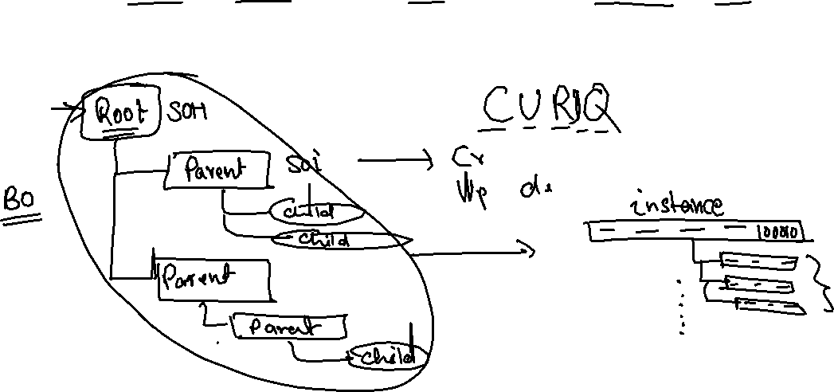
Components in RAP app – Technical Level
CDS entities – To develop our RAP BO (Business Object)
Business Object here is a TREE data structure which is composed of multiple nodes (parent, child), The tree starts from a root node.
Once the business object is ready, we define the behavior of the business object like can this object be created, updated, deleted. Business object is a static structure (like a class) and the records of actual data is the instance of BO (object of a class).
Finally we can create service definition and service binding
UI layer to consume the service to build application.
www.anubhavtrainings.com

Slide 9
Development Approach
Application UI (Fiori Apps)
Transactional | Analytical | Factsheet
Analytical Tools
Excel | SAC | Other..
Third Party
Your own ABAP code
Service layer (expose data over HTTP/HTTPS protocol) – OData Services (V2, V4)
SEGW, SADL, @OData, Serv. Definition and Binding
API Layer
Business logic, Data validations, Lock Unlock, Sync. Points, Branches, Manipulation logic, data flow logic, processing logic - RICEF
Customizing layer (SPRO, SM30)
Database Layer – (function modules and classes to interact with database)
LUW, Update FM, BAPIs – SELECT INSERT MODIFY UPDATE DELETE, EQ, DQ
SE11 – Data Dictionary – Tables, Views, Data Elements, Domains, LO, MC…
www.anubhavtrainings.com

Slide 10


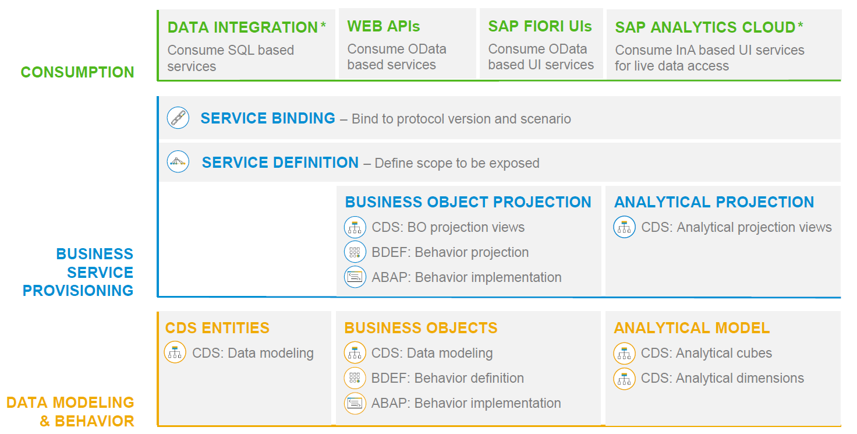
RAP – The Big picture
www.anubhavtrainings.com

Slide 11
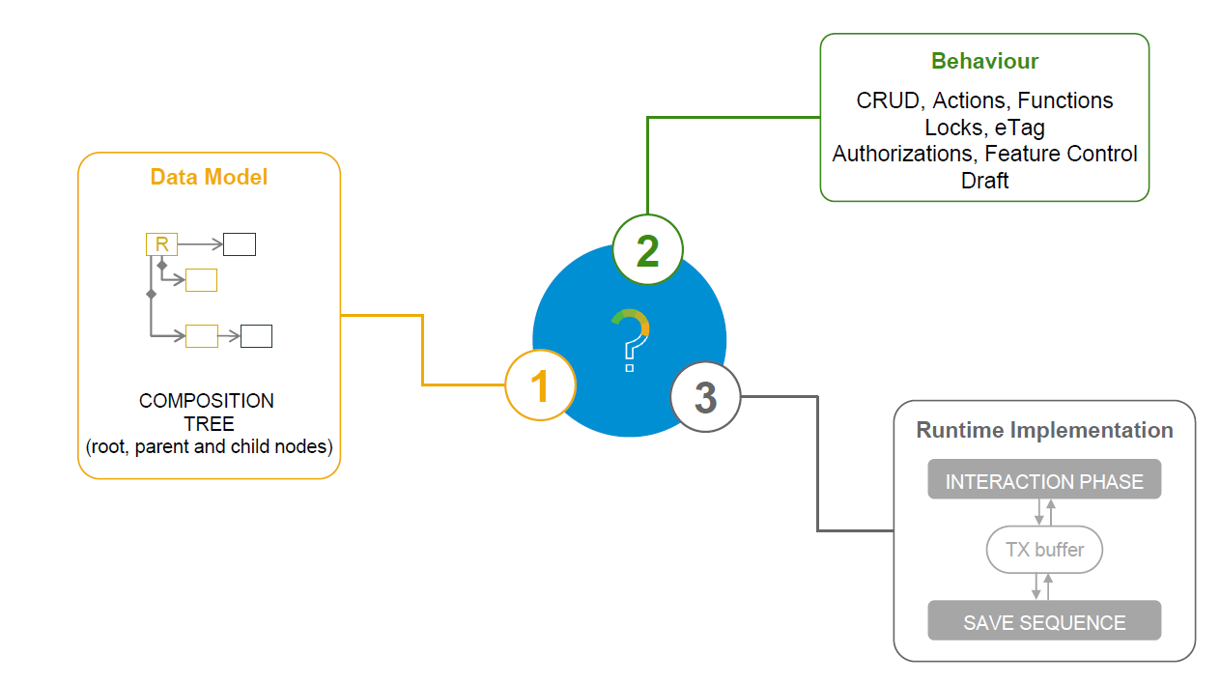
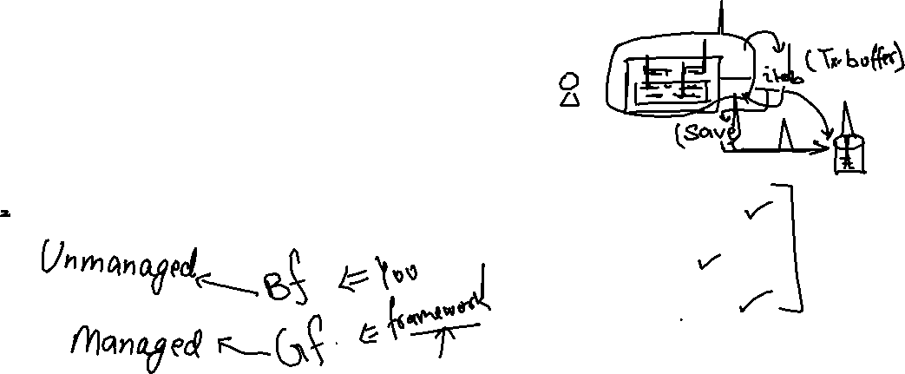
What is a Business Object
www.anubhavtrainings.com

Slide 12
Types of Implementation (Scenario)
Brownfield Implementation
Is used when we want to create a transactional application which can insert, update, delete data from the system by writing your own logic
You already have Business logic with you and you want to use that business logic to perform transactional capability
You are own your own to manage your implementation.
02. Managed Scenario
Greenfield Implementation
Is used when we want to create a transactional application which can insert, update, delete data from the system by using the framework provided implementation
You do not have Business logic with you and you want system to create business logic for you automatically.
01. Un-Managed Scenario
www.anubhavtrainings.com

Slide 13
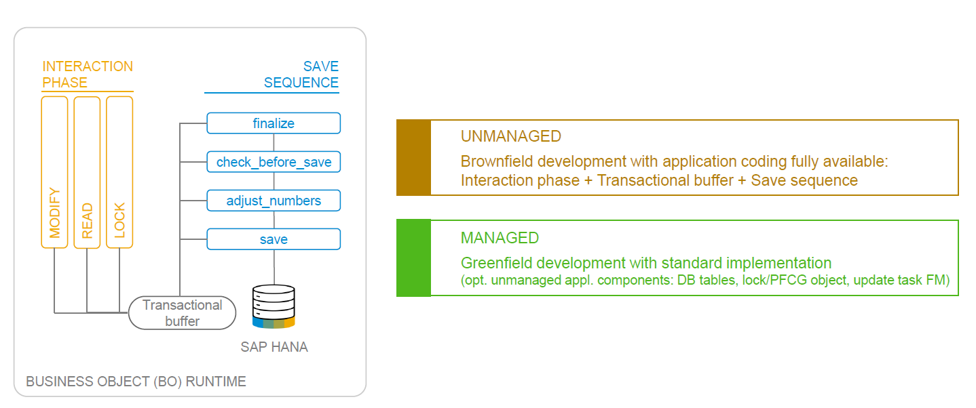
BO Runtime Implementation Types
www.anubhavtrainings.com

Slide 14




















Slide 15

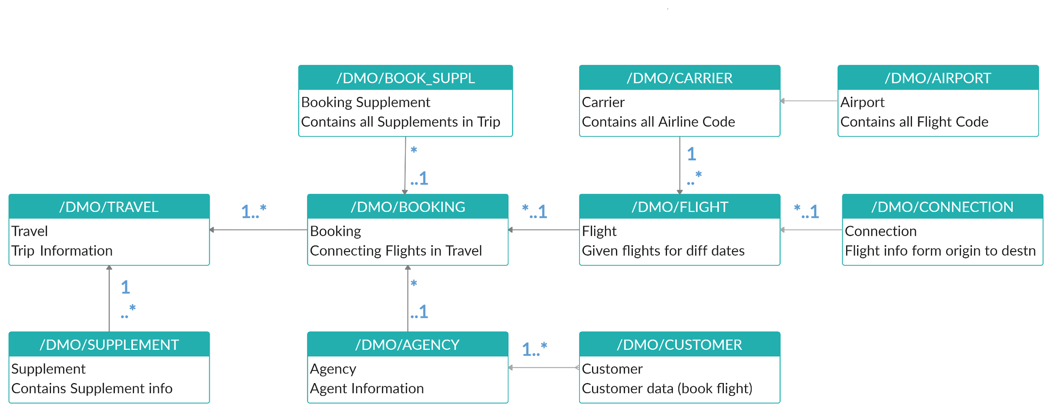



Explanation of Flight Data Model
_M
_M
_M
If Data is not found in these Table’s please execute Data Generator Class “/dmo/cl_flight_data_generator”
www.anubhavtrainings.com

Slide 16
Managed RAP implementation
The managed RAP implementation addresses use cases where all the essential parts of the applications are to be developed from scratch. However, these new applications can highly benefit from out-of-box support for transactional processing. Standard operations like create, update, delete must only be specified in the behavior definition to obtain a ready-to-run business object. The provisioning of transaction buffer is also done automatically for us by the framework. The interaction phase and save sequence are also implemented generically. The application developer can focus on business part of app like adding custom validation, actions, determinations. The RAP transaction engine manages the life cycle of our Business object and covers all the aspects of our app development.
The managed implementation type is aimed for building new applications from scratch without having any prior coding exist. The standard functionality that given in managed business objects is easily retrieved. The business logic implemented using predefined implementation methods that are integrated during the runtime in the interaction phase and save sequence.
www.anubhavtrainings.com

Slide 17



Business use case
We will implementing 2 different applications on travel data model. These applications will target different user groups. We will manage the travel requests and booking through our applications which are booked by agency for customer.
Processor – a processor is an employee of our company who will request a new travel plan through the application. He/she will be allowed to create, update, delete, copy travel requests including bookings and supplements. They have full control to manage their travel.
Approver – an approver is a manager who will only be able to view the travel requests created by employees, and can only change the booking fees and approval status of the request (approve/reject).
MakeMyTrip.com- processor app
Processor needs to create, update, delete a travel request through agency including all bookings and supplements
Approval App
The manager would review the travel requests created by processor, can only change the booking fees and approve or reject the travel request
www.anubhavtrainings.com

Slide 18





























Slide 19
Understanding projection
If we ever get requirement in our company to develop a use case where we want to reuse the data model (e.g. sales, purchase, accounting, finance) but develop many applications. We will go with RAP and projections. A projection takes part of the base functionality according the needs to user. This will reduce effort, increase reusability in our app.
www.anubhavtrainings.com

Slide 20

What We Did
Let’s Summarize

Slide 21

www.anubhavtrainings.com
Thank You
End of Day 15

Slide 22


We’re committed to empower you to be
#FutureReady
through powerful training solutions.
We build the workforce of the future.
260+
Corporate Clients
60,000+
Learners Trained
26000+
Learners Placed
FREE WEBINARS
Sign up for free webinars with industry experts every fortnight!
Enroll Now!
Contact us today!
https://anubhavtrainings.com

